Slide 1
Project: Security Lock System
Project owner:
Rohan Vishawakarma : 3553424
Saurabh Borse : 3551516
No. of slides:10
Duration of presentation: 10 min.

Slide 2
System Description and Functionality
System Description:
Security lock system consists of a Light Barrier sensor, Key-Pad, Servo-Motor, ESP-32, IO-Shield & IO-master
Hardware Description:
Light barrier sensor: gives digital output
Key-pad sensor: 10 numbers, 4 alphabets and 2 special character as input
Servo motor rotates 0-360 degrees
ESP-32microcontroller: communicates to the I/O link Master via the I/O link Device shield
Functionality:
The light barrier sensor detects when a card is entered in the system and enables the Key-Pad to enter the password. Upon password validation the Servo-motor opens the door

Slide 3
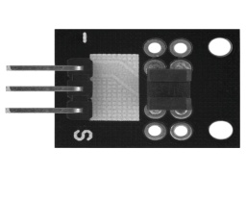
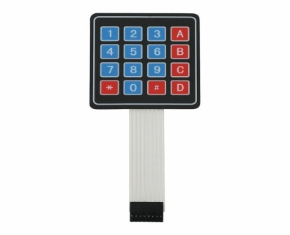
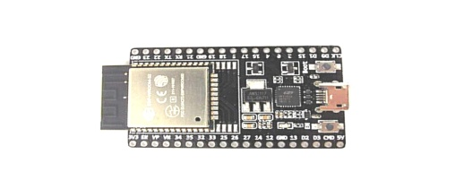
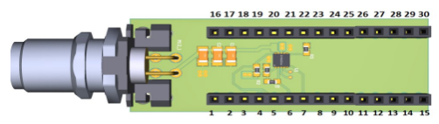
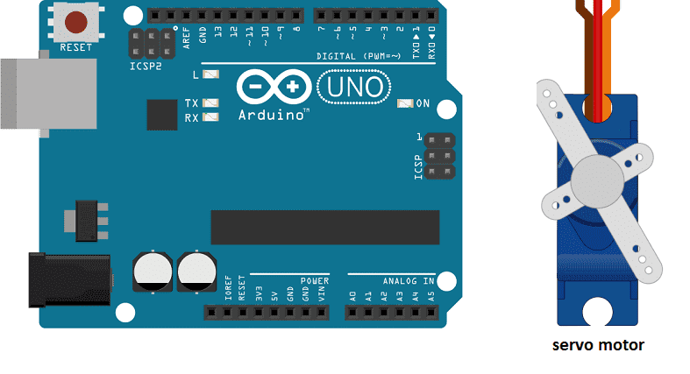
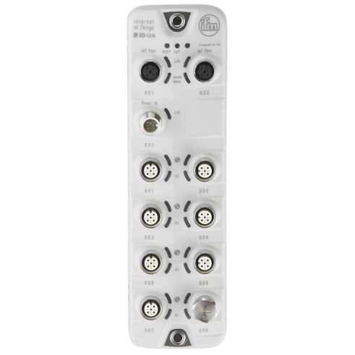
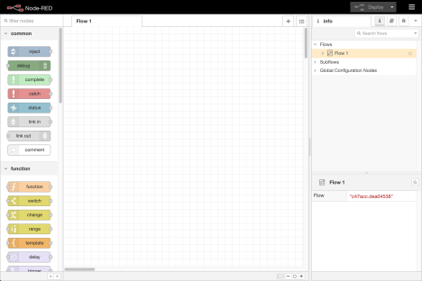
System Architecture
Sensor1: light barrier
SPI Interface
Microcontroller: ESP32
I/O Link shield
Sensor2: Key-pad
User
I/O link com.
Actuator: Servo motor
TCP/IP Interface
Logic controller & GUI
I/O Link master

Slide 4
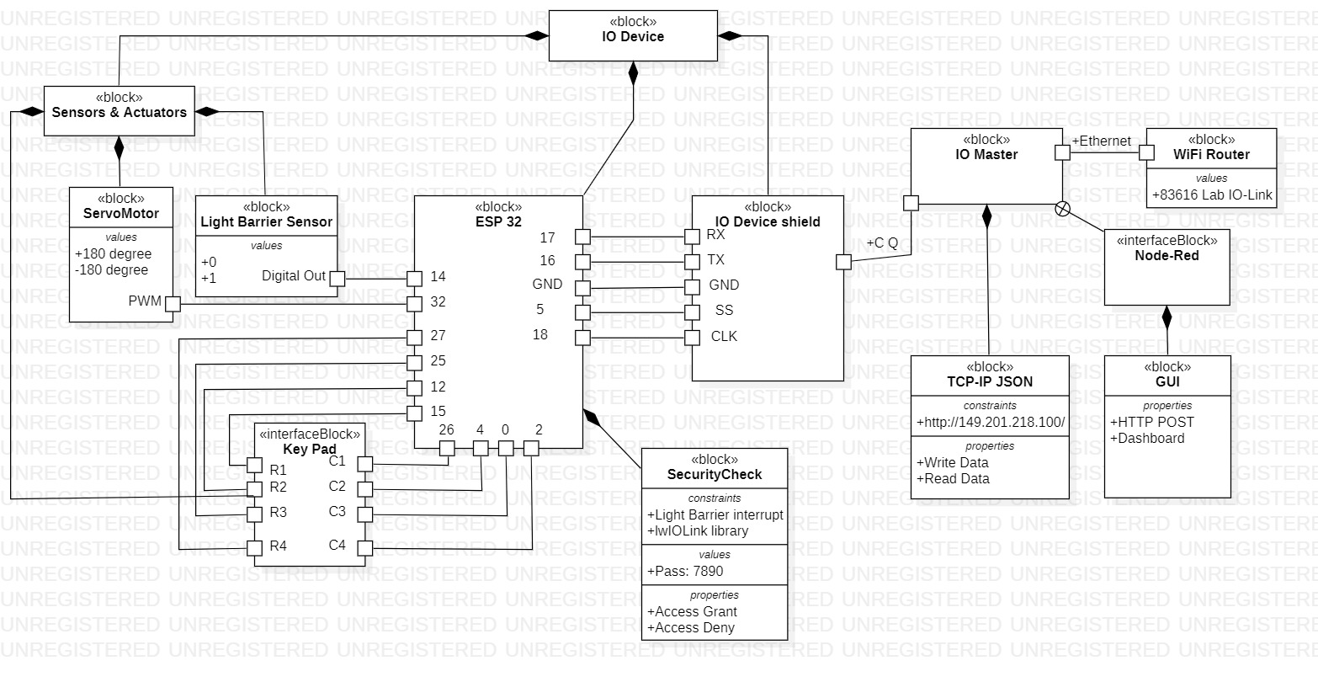
System specification: Block Definition diagram

Slide 5
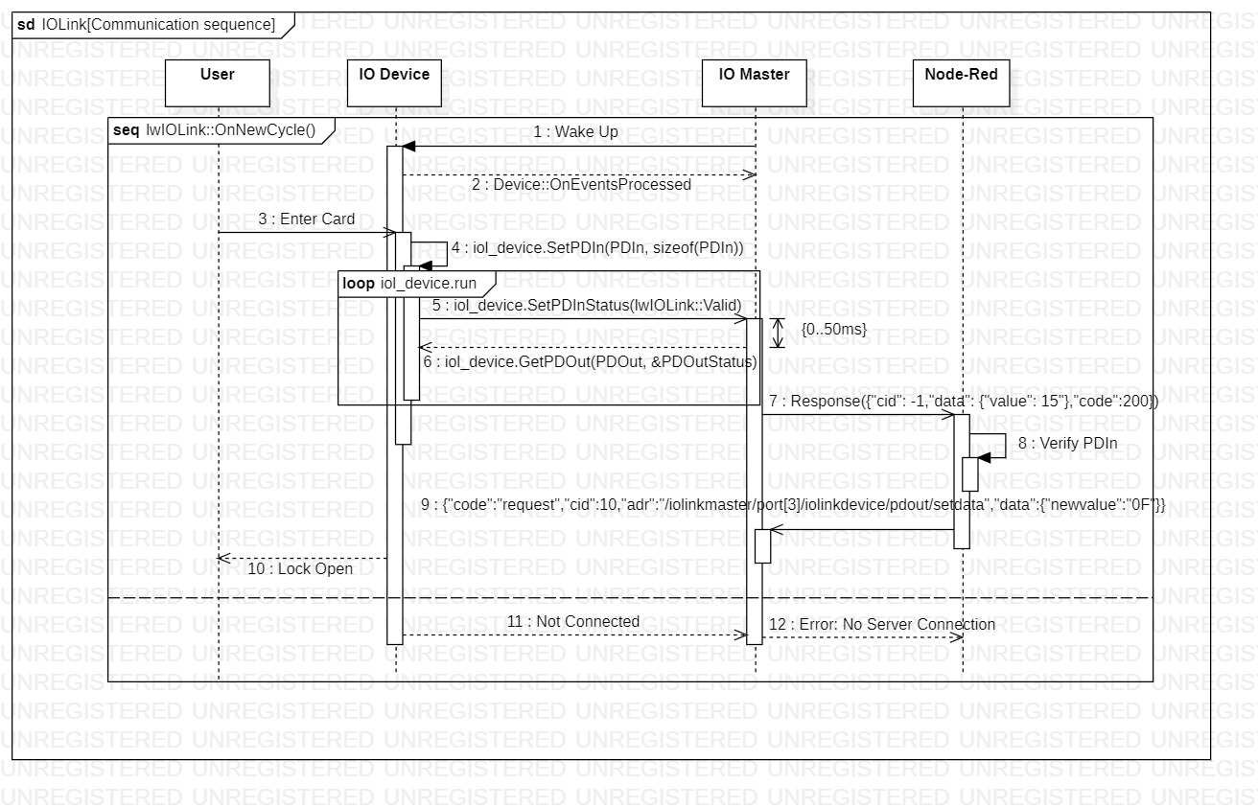
System specification: Sequence diagram

Slide 6
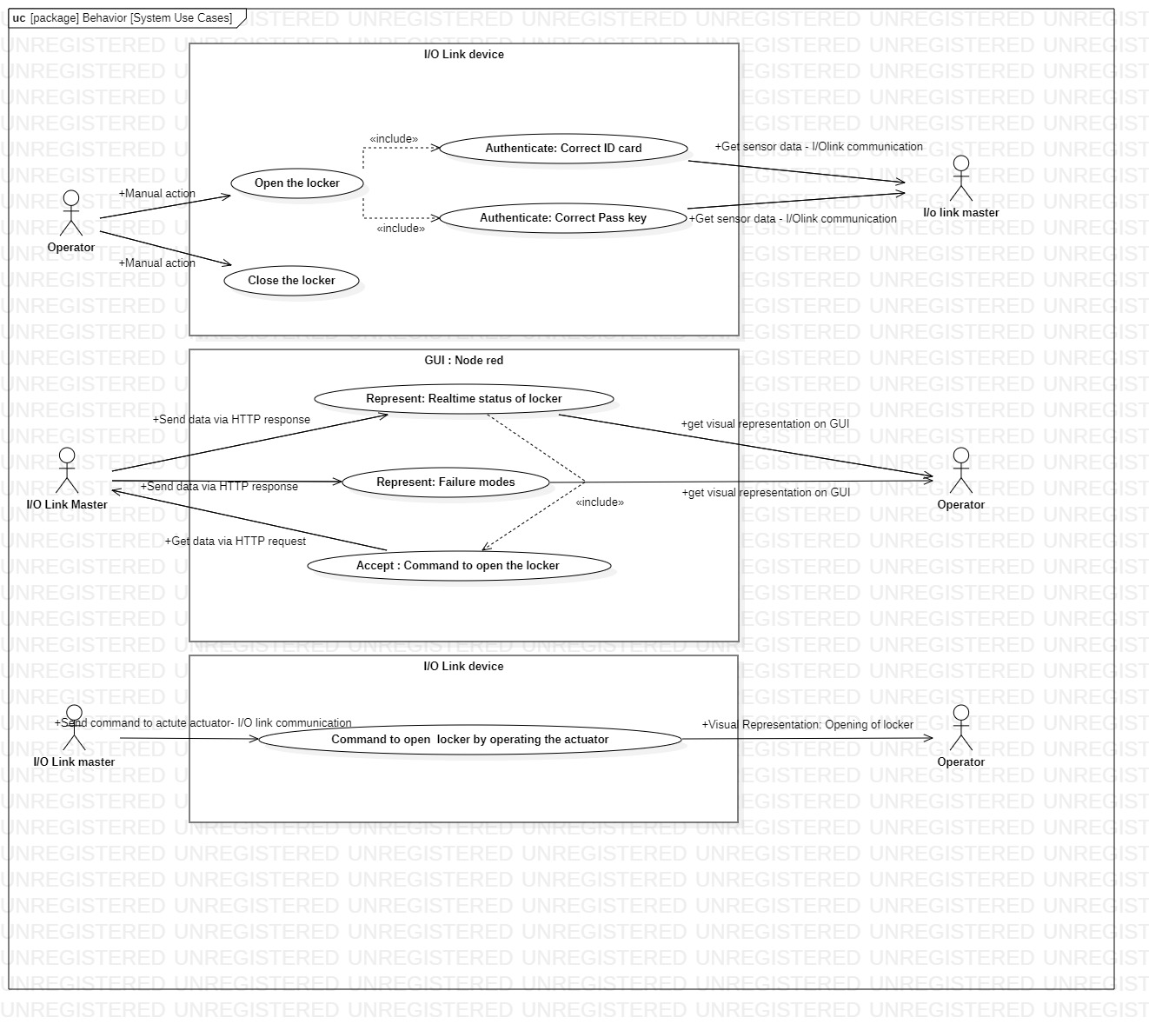
System specification: Use cases

Slide 7
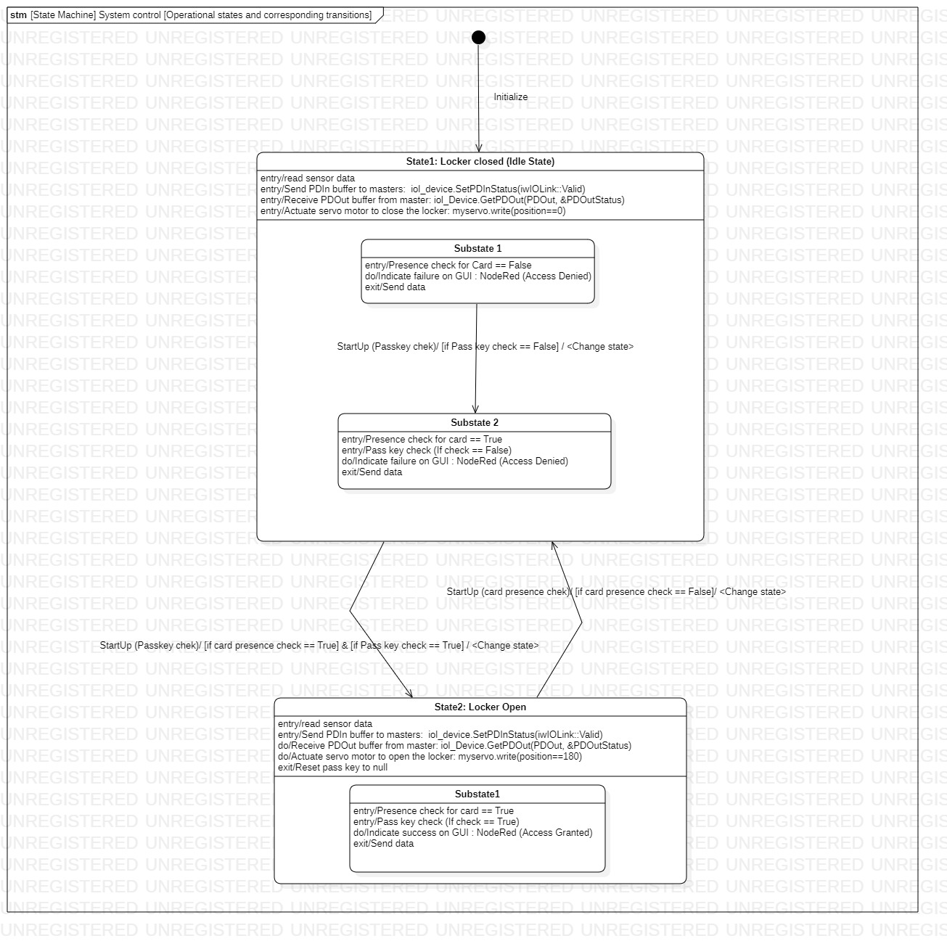
System specification: State Machine Diagram

Slide 8

Execution and Testing: Manual Mode
Video Demonstration:

Slide 9
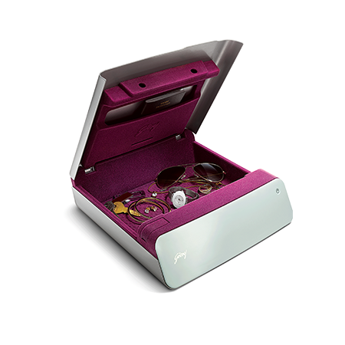
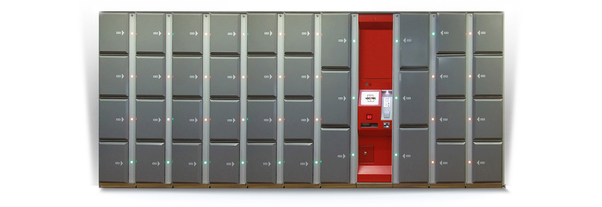
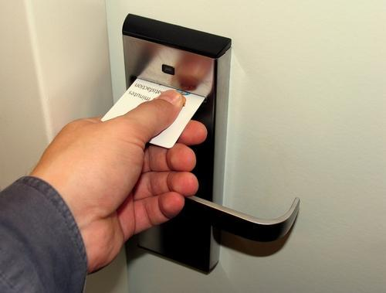
Applications and Product improvement
Applications:
1. Personal Lockers
2. Array lockers : Institutions /Organizations
3. Door locks
Product Improvements:
Unique ID cards by using RFID reader or card reader can be implemented to enhance system response
Unique device Identification by using Smartphone authorization
Biometric scan identification to enhance system reliability

Slide 10

Thank You !!

